Slide 1
Blackjack
By Tse Saunders, Thomas Schmidt, and Aaron Tyler

Slide 2
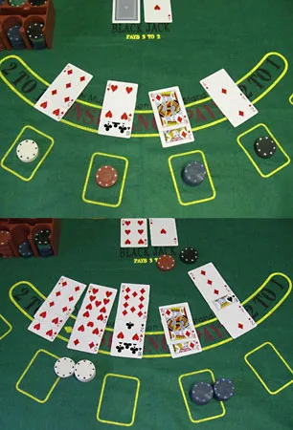
Our Vision/Motivation
A fun, yet competitive luck-influenced strategic game to play with friends
Very easy to understand, but has a shockingly high skill ceiling.
Good form of digital interaction with lighthearted fun.
No actual gambling functionality, so it will serve as a way to play blackjack without monetary risks

Slide 3
TA Feedback
There was a struggle finding a way to maintain unique IDs for players to keep server-client interactions specific to certain players
TA recommendations:
Server assigns IDs when connection is made
Server keeps IDs unique
Tracks IDs in cases of connections/disconnections
Sends IDs back to clients so clients can know where to load GUI elements
The creation and maintenance of player/client IDs

Slide 4
Potential Problems…
How will networking be implemented properly to connect users?
How can we have the server constantly monitoring the state of the game?
What should be the range of chips a user may have? What rules should be in place? Round limits? Different ways to design the game.
Frontend design: How do we have it differ for each user without affecting the gameplay/design too much?

Slide 5
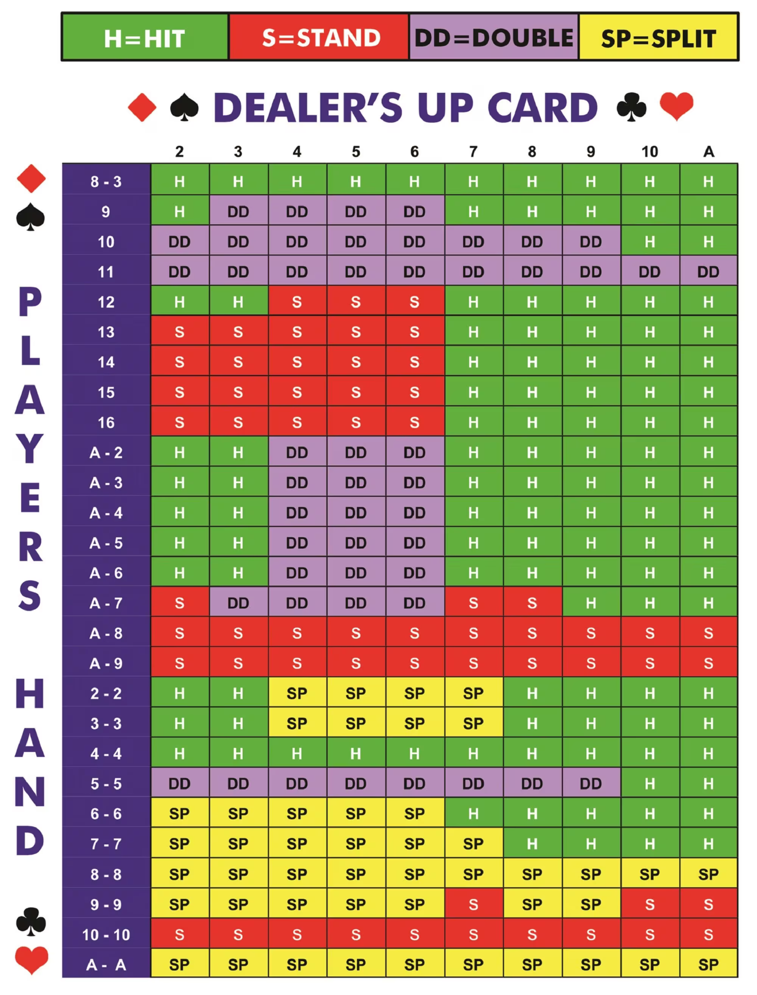
Problems We Actually Ran Into…
Assigning each player their own ID once joining the server
Monitoring 4 decks, 6 player hands, a dealer's hand, and all player moves at the same time
Monitoring gameplay with the potential of a player hitting 4+ times (and ensuring all other players see them doing so)
Certain PNGs and JLabels/Buttons disappearing randomly
Total chip amount visible for some screens but not others?
Implementing the split function
One works = One breaks

Slide 6
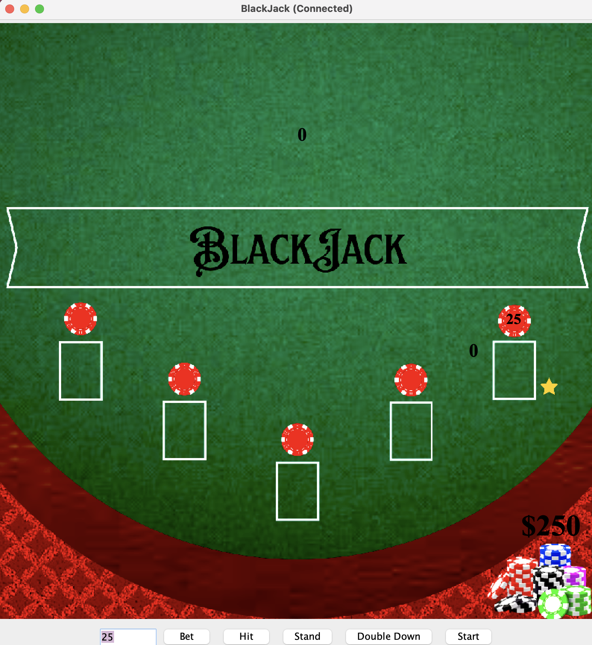
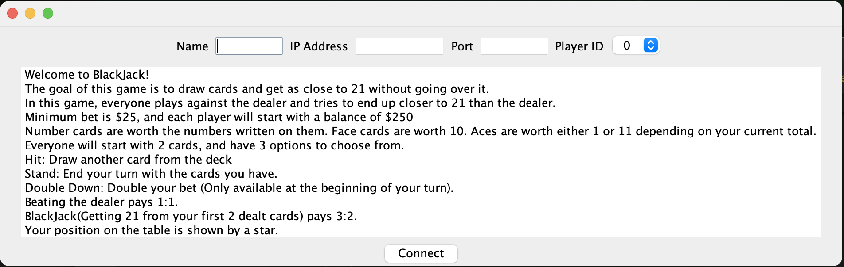
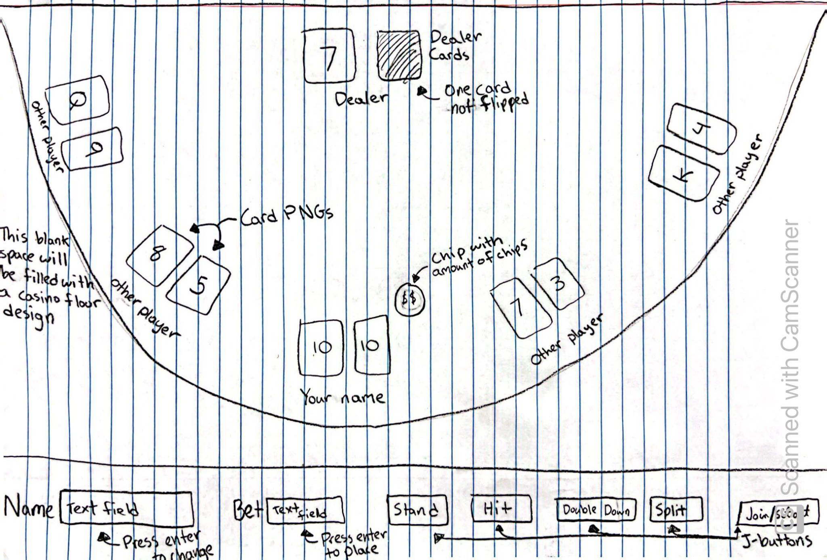
The GUI
Our GUI Evolved from a few PNGs textures found through google search.. After facing some difficulties in design, we were successful in getting the chip amounts in the bottom right, the betting amount in the red chips above all white squares (player slots, where yours is indicated by a yellow star, and the dealer cards + hand value.

Slide 7
Testing Plan
Although we need to test a multitude of scenarios, here are a few examples of what we looked for throughout the coding process:
Confirming that 5 clients are able to connect to the server and the sixth is refused due to the game room being full.
Check that the betting amounts are within the bounds that we set (greater than 25, less than x) where x is the amount of chips a player has.
Deliverables are functional, including the server that the clients connect to, the threads and sockets used to run each function, and the GUI of the blackjack table because that is how the client will interact with the server.

